Slide 1
RESEARCH INFORMATION MANAGEMENT
WirTRIALS
Members: Mayuri Pandey
Swagat Gyawali
Hongru Ren
Experts : Martin Gaedke
André Langer
Dang Vu Nguyen Hai

Slide 2
PRODUCT LAUNCH
OF SPRING 2021

Slide 3
MOTIVATION:
FOR A BETTER RESEARCH

Slide 4
Recall: How did you complete your Bachelor Thesis?
Selecting Topic
Searching Advisor
Researching Related Work
Implementing project
Writing Thesis
...

Slide 5

Polling
In which part, the experience of students could still be improved? (lack of tools, or current tools hard to use)
Notes:
Welcome to participate in our online polling through this link:
http://etc.ch/bJNN

Slide 6
Problem
How to search for advisers, if you have chosen a topic?

Slide 7
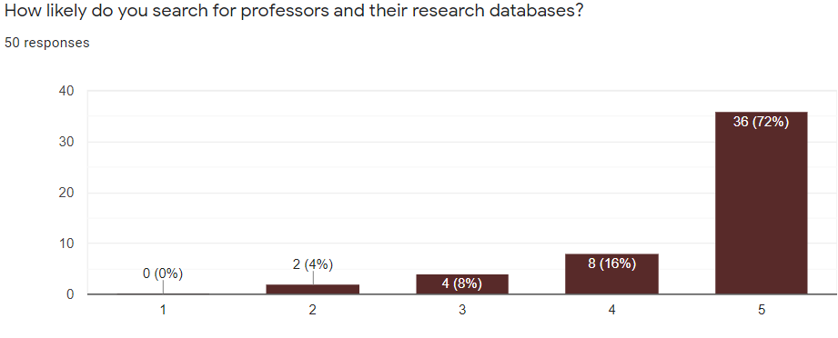
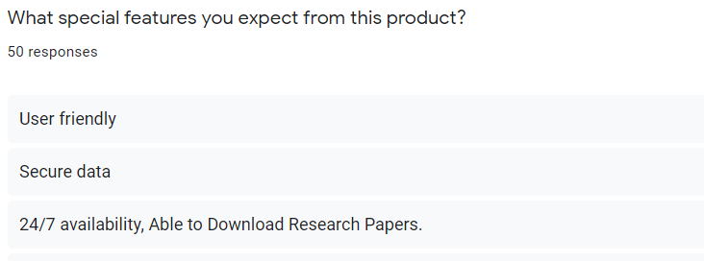
Survey

Slide 8

Our Company
WirTRIALS
”Fast-forwarding Ideas into Reality”

Slide 9
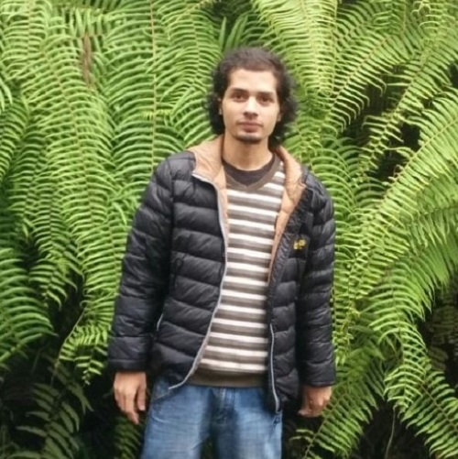
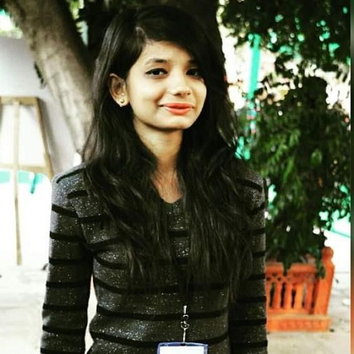
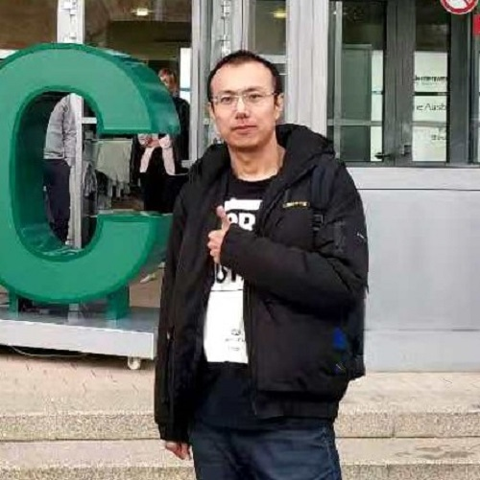
Our Team
Mayuri Pandey
Hongru Ren
Product Manager
CEO
Swagat Gyawali
CTO

Slide 10
Our Culture
Mission
Vision
Purpose
To achieve a connection between ideas and the real world by developing tools which are custom built, simple and user-friendly.
To become a paradise for technophile and a channel from fantasy to reality.
To support our clients to excel in new technologies and thereby going hand in hand to forge the digital future.

Slide 11
Problem
How to search for advisers, if you have chosen a topic?

Slide 12
Scenario I
Sabine has great interests in the domain of cyber-physical system.
She needs to find a professor to advise her thesis on this topic.

Slide 13
Scenario II
Christian is working on his thesis about human-computer interaction.
He wants to find and talk with experts in the domain of eye tracking.

Slide 14

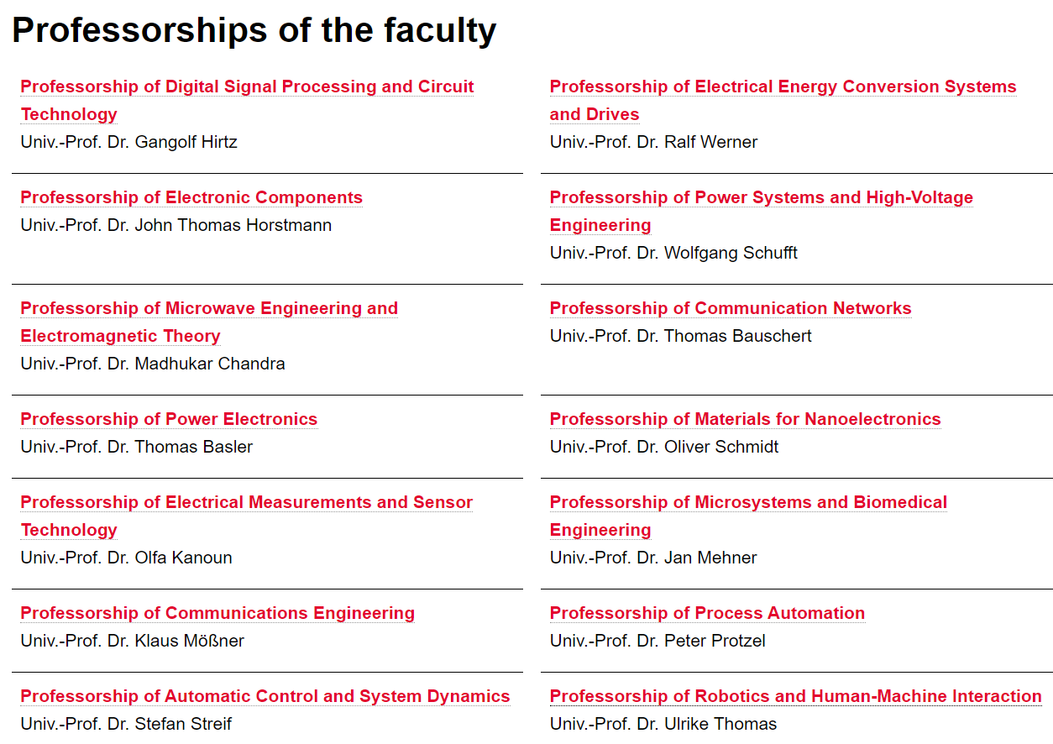

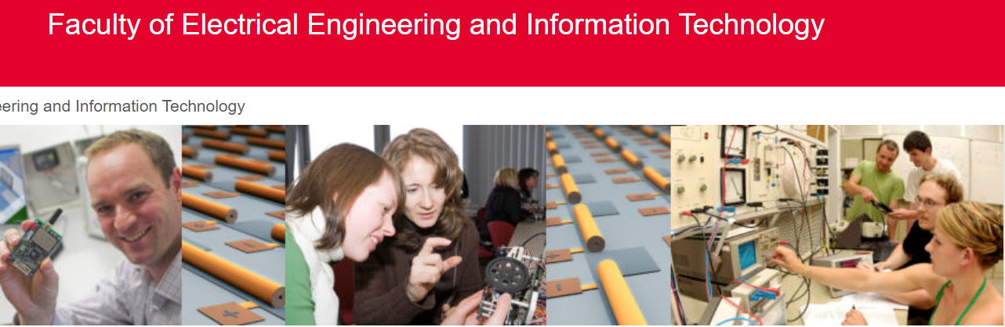
Current Tools - Who are Experts of Cyber Physical System?
OR/AND ?
Notes:
Cross domain topic, time consuming

Slide 15

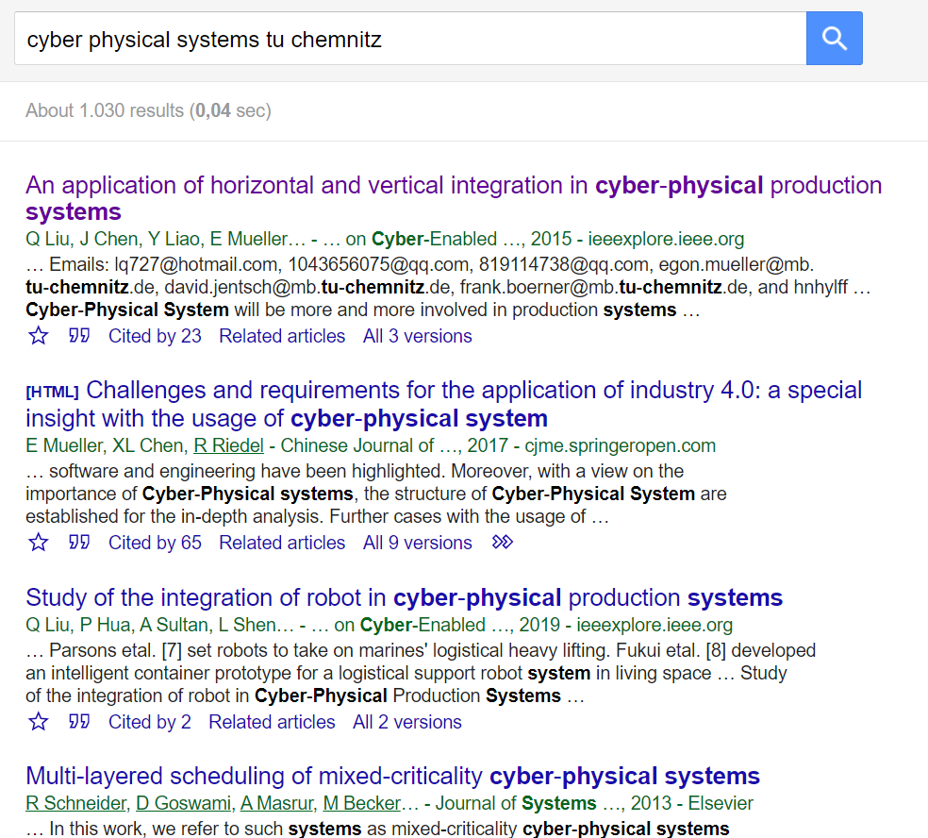



Current Tools - Who are Experts of Cyber Physical System?
...

Slide 16
Current Tools - Shortages
Time Consuming
Hard to Use, Unfriendly, Unsatisfactory

Slide 17
OUR PRODUCT:
RESEARCHEE

Slide 18
Our Product: Researchee
9,752
Target Users
There are
Junior researchers, students and other staff in TU Chemnitz
students in TU Chemnitz
(on 12/01/2020 from TUC website)

Slide 19
Researchee - Data Scale
4,164
Final Goal
We have archived
Improve the experience of searching for research information
research areas in our database
(until 25.03.2021)

Slide 20
Researchee - Data Scale
166
1,773
We have archived
We have archived
Professors of TU Chemnitz in our database
(until 25.03.2021)
Researchers of TU Chemnitz in our database
(until 25.03.2021)

Slide 21

Researchee - Data Resource
Notes:
LDAP Server

Slide 22
Researchee - Data Statistics
81%
36%
100%
43%
Professor has expertise
Researcher has expertise
Research areas has a WikiData ID
Staff has an id of ORCiD
135 / 166
640 / 1773
4164 / 4164
840 / 1939
* more statistics of database will be shown in the live demo
Notes:
We didn’t archive expertise without an id

Slide 23
Researchee - Data Structure
RDF
XML / JSON-LD
Subject - Predicate - Object Triple
Serialization format

Slide 24
Researchee - Implementation Roadmap
STEP 2
STEP 4
STEP 1
STEP 3
STEP 5
Data Extraction
Data Integration
Looking for Data Resources
Data Mapping
Data Visualization

Slide 25
Researchee - Features
Search experts based on expertise
Search experts based on name
Statistics of staff and expertise in TUC
3D Visualization of expertise and publications
Link expertise and expert within system
Link both to public persistent ID
* more details of visualization will be shown in the live demo

Slide 26
LIVE DEMO:
WirTRIALS

Slide 27
Future Aspects:
Classify the granularity of expertise in more details
Add more information resources
Add projects and events related to a researcher

Slide 28

THANKS
Do you have any questions?
wirtrials2020@gmail.com
www.wirtrials.com

